Slide 1


Easy Rebranding Service

Slide 2
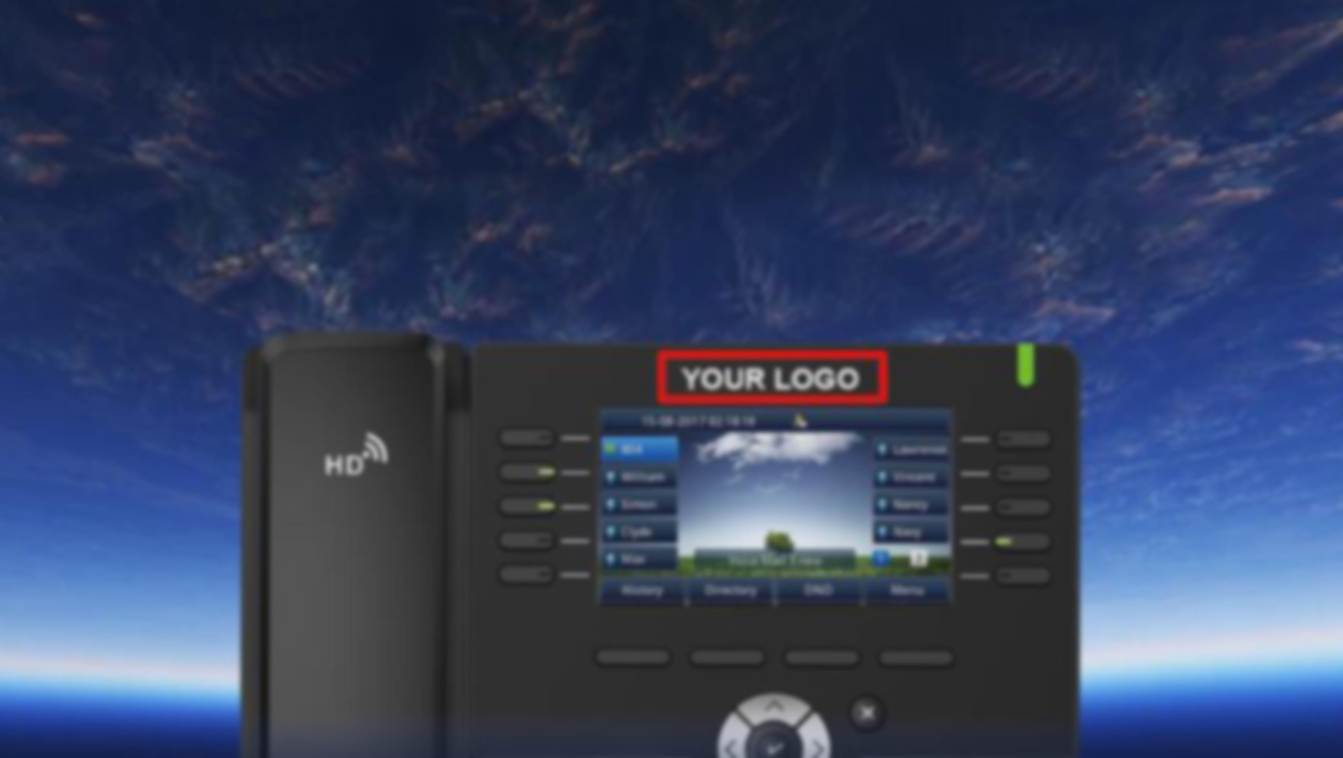

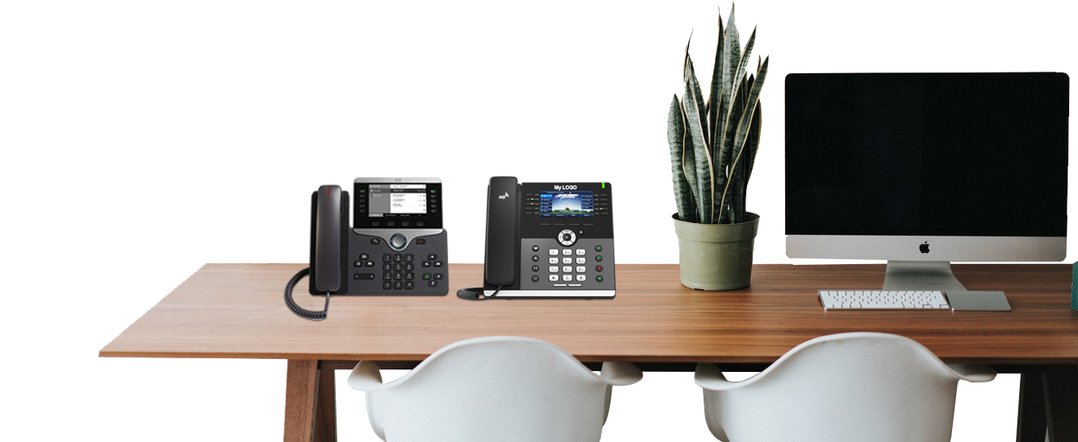
Most Phone Systems Are In Service 5 to 15 Years
“What Brand Is On Everyone’s Desk ?”
•AT&T •Lucent •Avaya •Nortel •Samsung
•Mitel •Yealink •Polycom •Cisco •Shortel

Slide 3
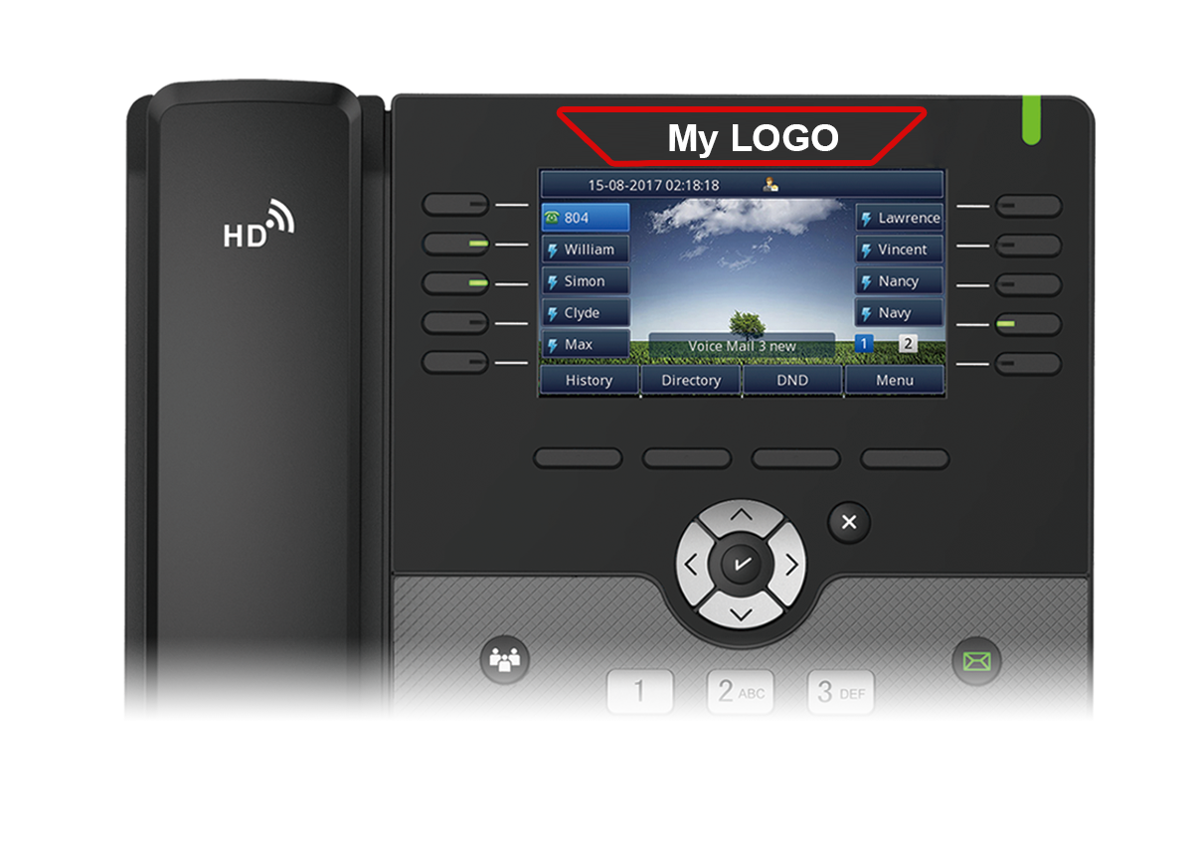
Why Isn’t YOUR BRAND on YOUR PHONES??
Make Higher Margins On Your IP Sets !!

Slide 4

Build Your Brand
Not Cisco, Polycom, Yealink or Avaya !
· We provide Custom Branding !
· Not a Sticker or a Plastic Button !
· We offer a 2 Year Warranty !

Slide 5
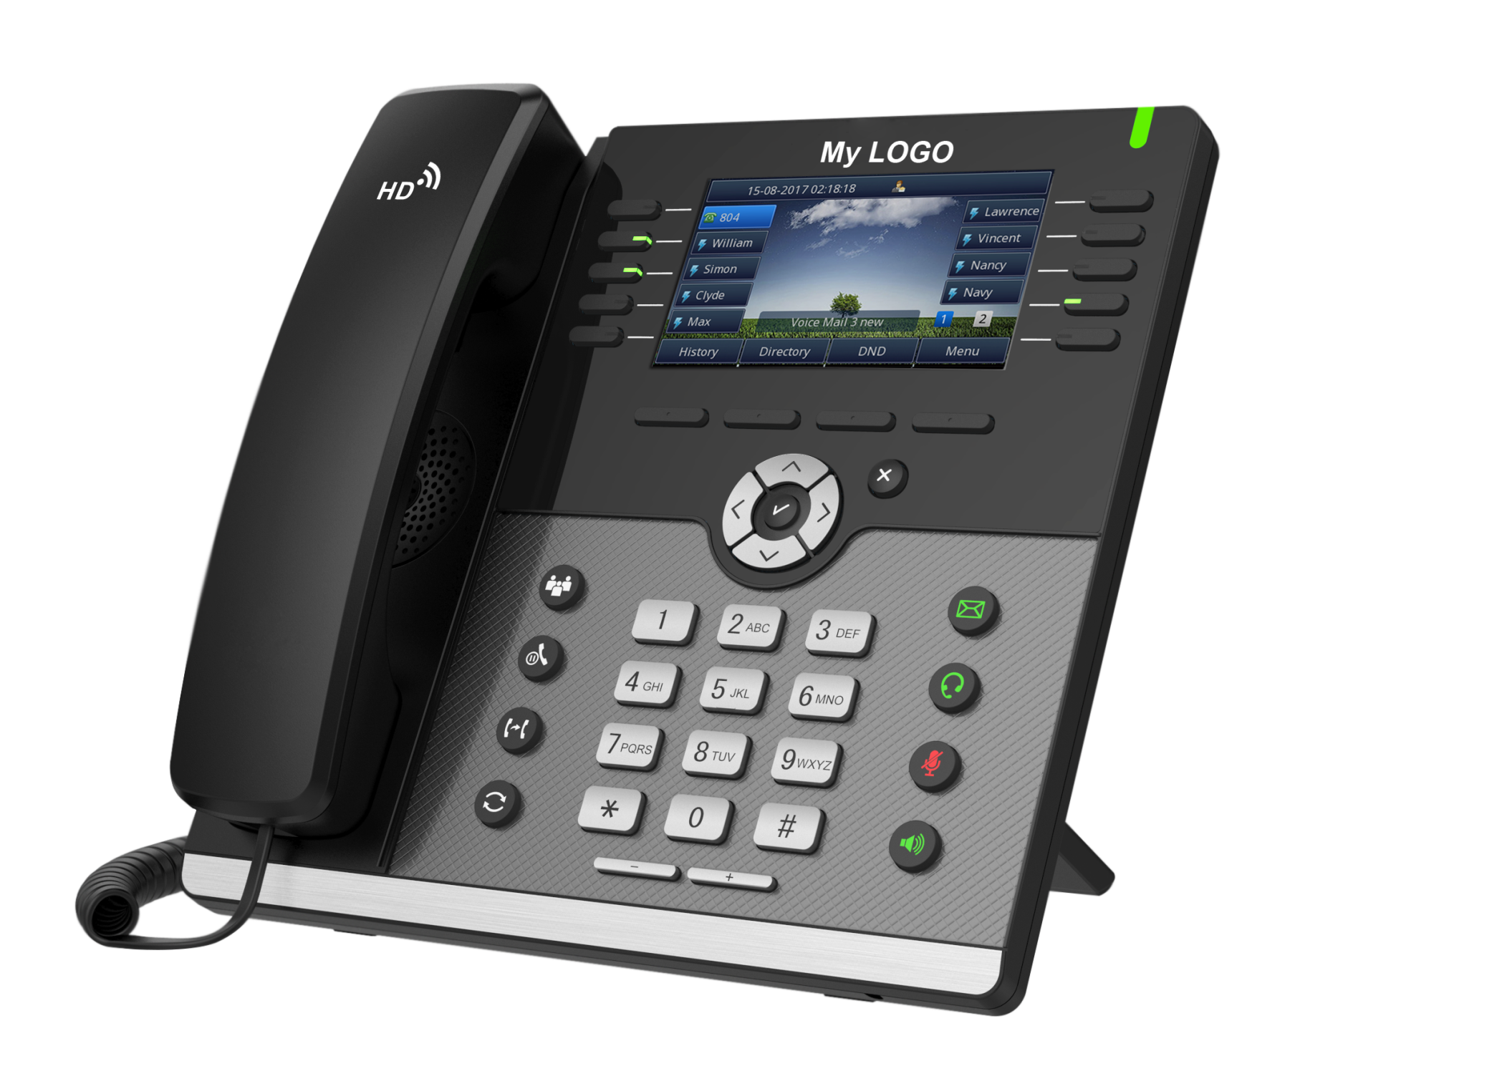
Your own brand &
Our advanced technology
· When anyone asks your customer, what phone
system they use
YOUR COMPANY IS THE ONLY BRAND ON THE
SYSTEM !
· With the amazing margins you make
on these products, offer internal
financing and use that additional
margin, to hire more technicians !
· Sales Assistance, Technical Support,
Marketing Materials all from local
Sales Team and Directly from
the Manufacturer !
· Demo phone available for testing
and provisioning to your platform !

Slide 6
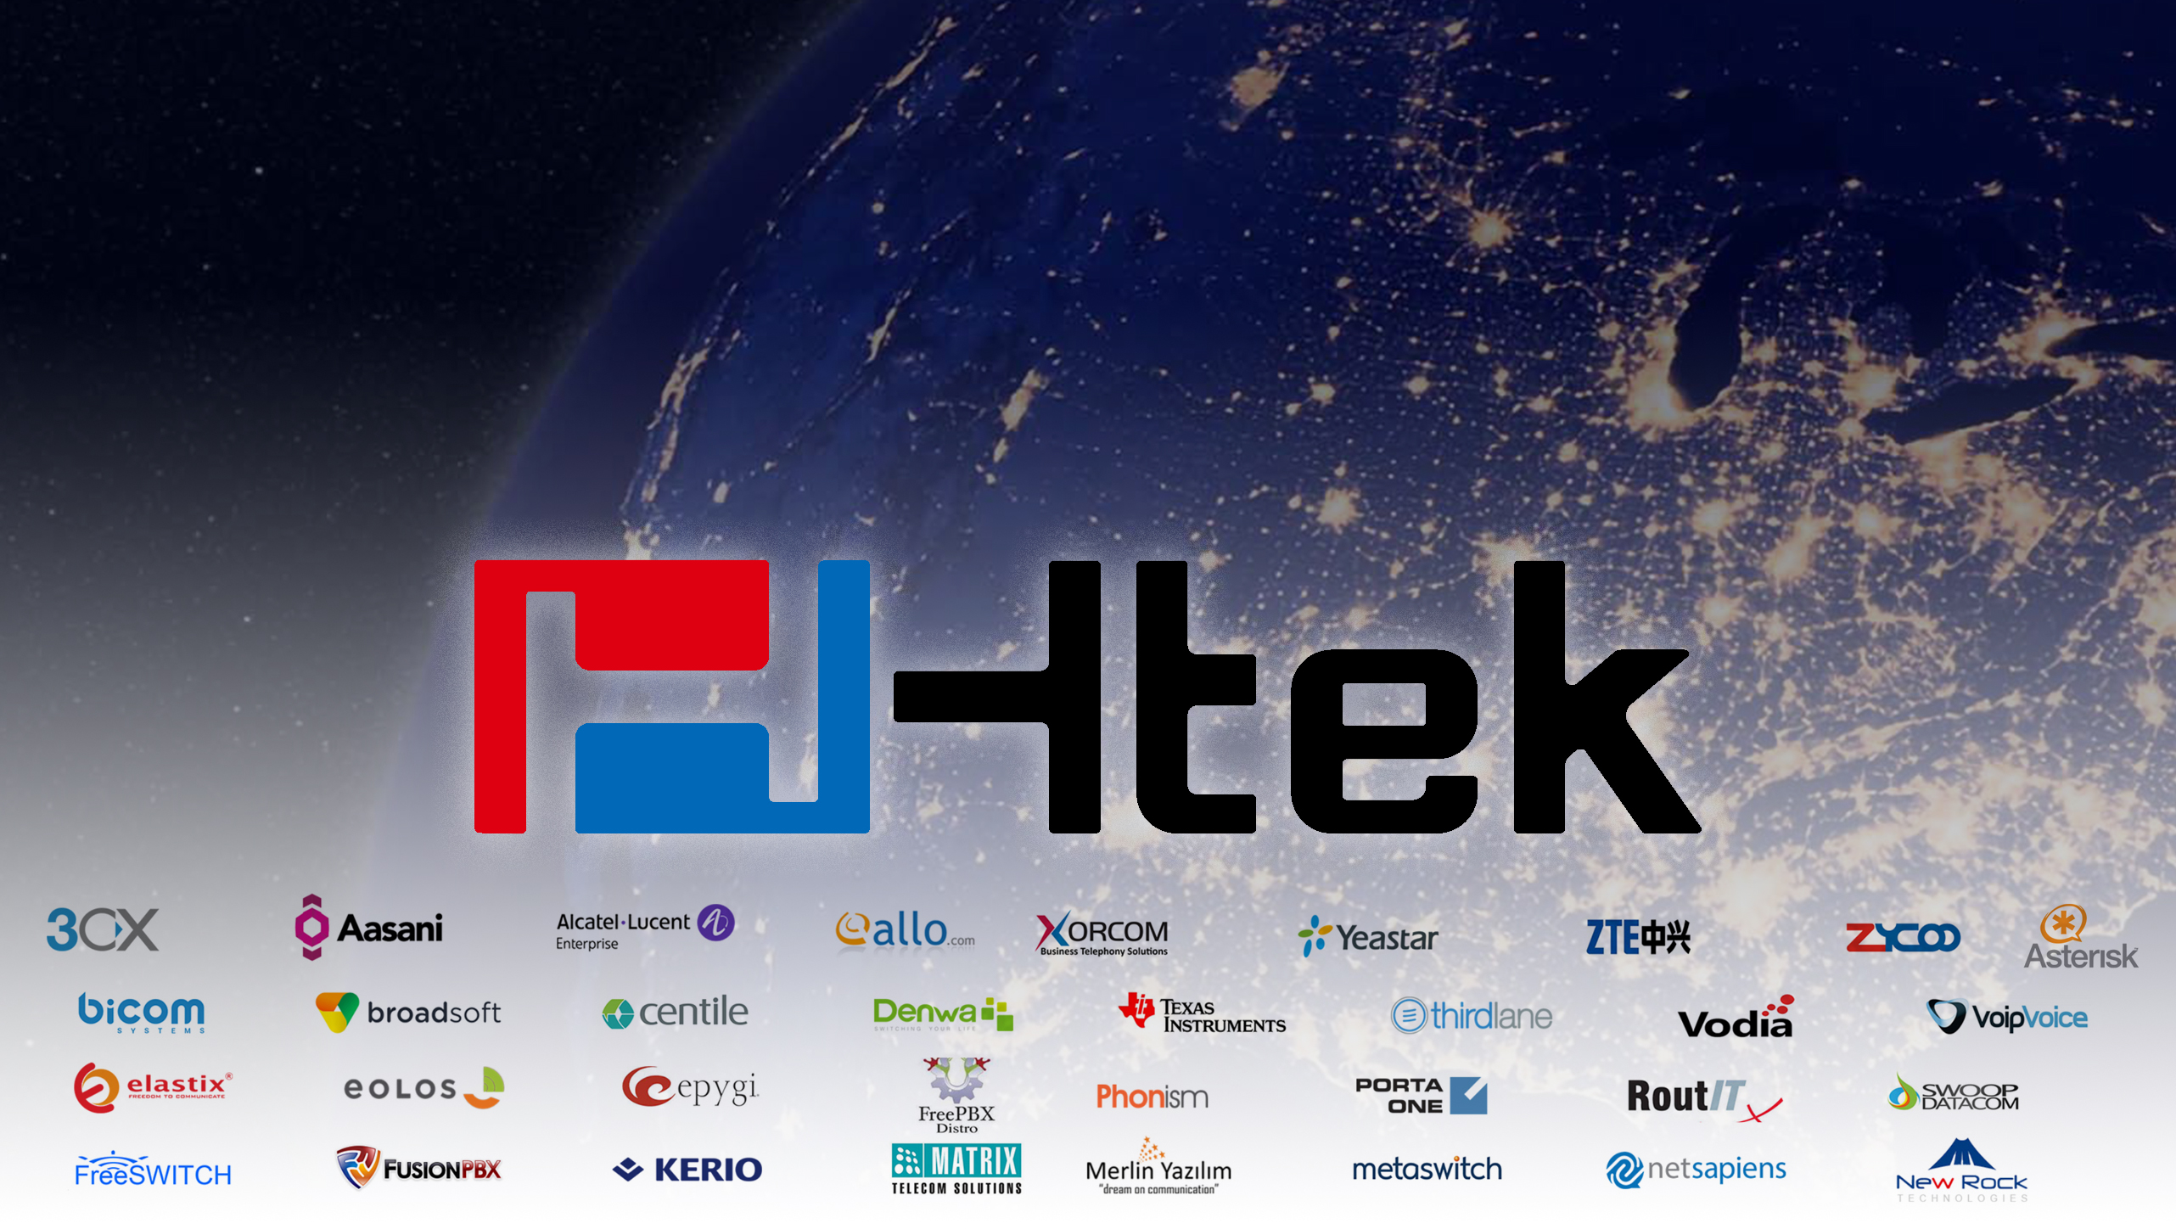
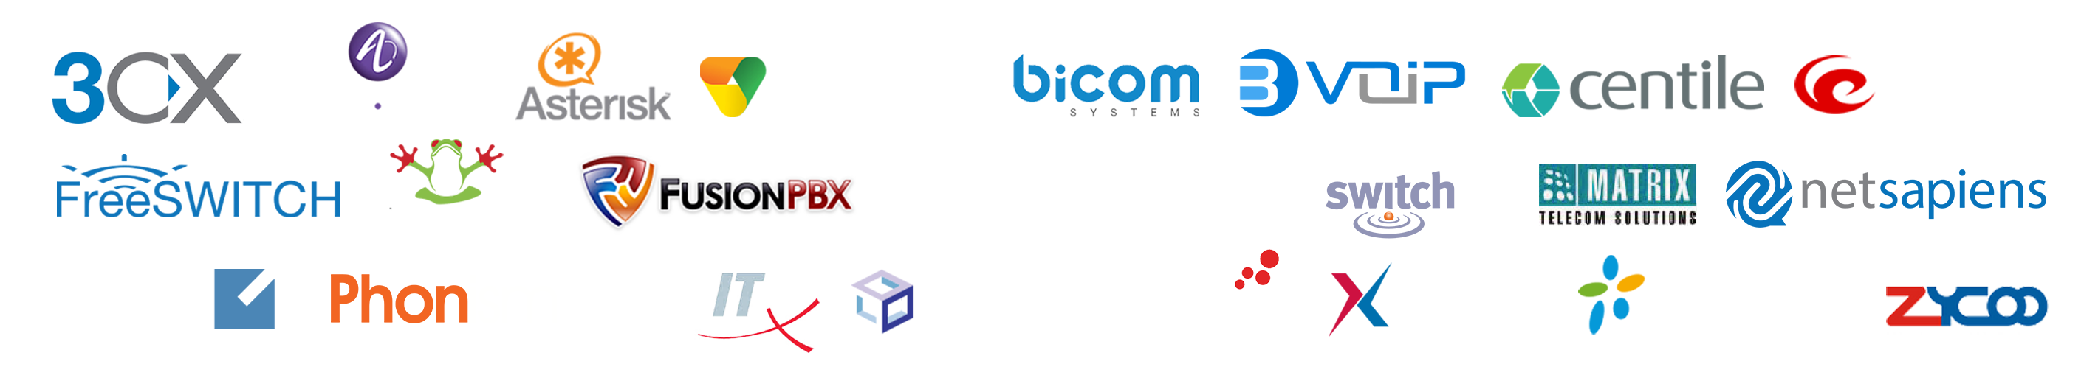
We Are Htek
A Quality Manufacturer of Innovative and Advanced IP Phones
We are your “Best Alternative” and “Best Choice” for a Channel Partner to provide your Company’s “Branded IP Sets” !!
Compatible with Mainstream IP PBX / Platforms

Slide 7

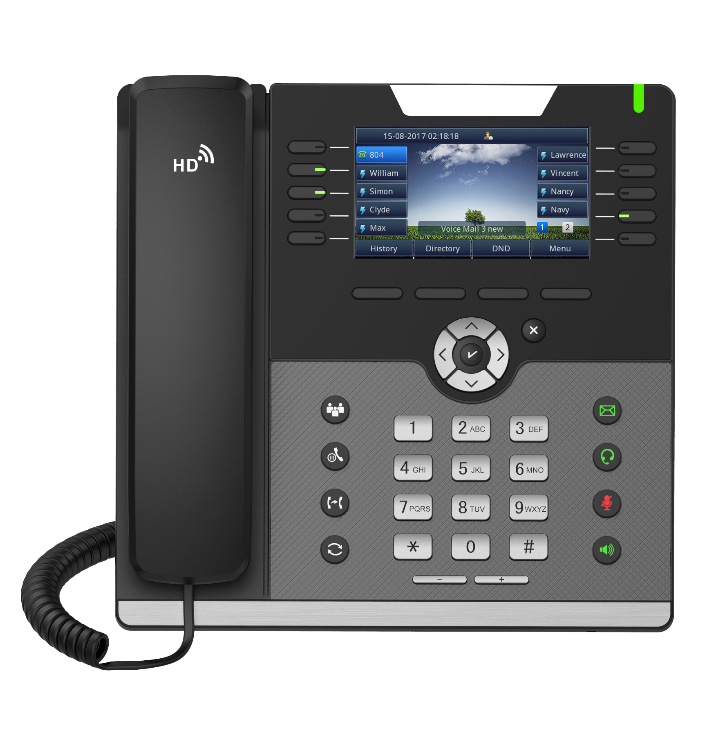
Easy Rebranding
To Boost Your Brand Image Is Our Mission
Stick Small Bezel Here

Slide 8
Available Model
UC912(E) /UC903 /UC923 /UC924(E)/UC926(E)
Rebrand Item
Phone logo -------------------------------------------- Customized
Giftbox ----------------------------------------------------- Standard
Bottom Label --------------------------------------------- Standard
Quick Reference ---------------------------------------- Standard
Software --------------------------------------------------- Standard
MOQ
Bezel Lead Time
Service Fee
Where To Buy
No
7 days
No
Htek Local Distributors

Slide 9
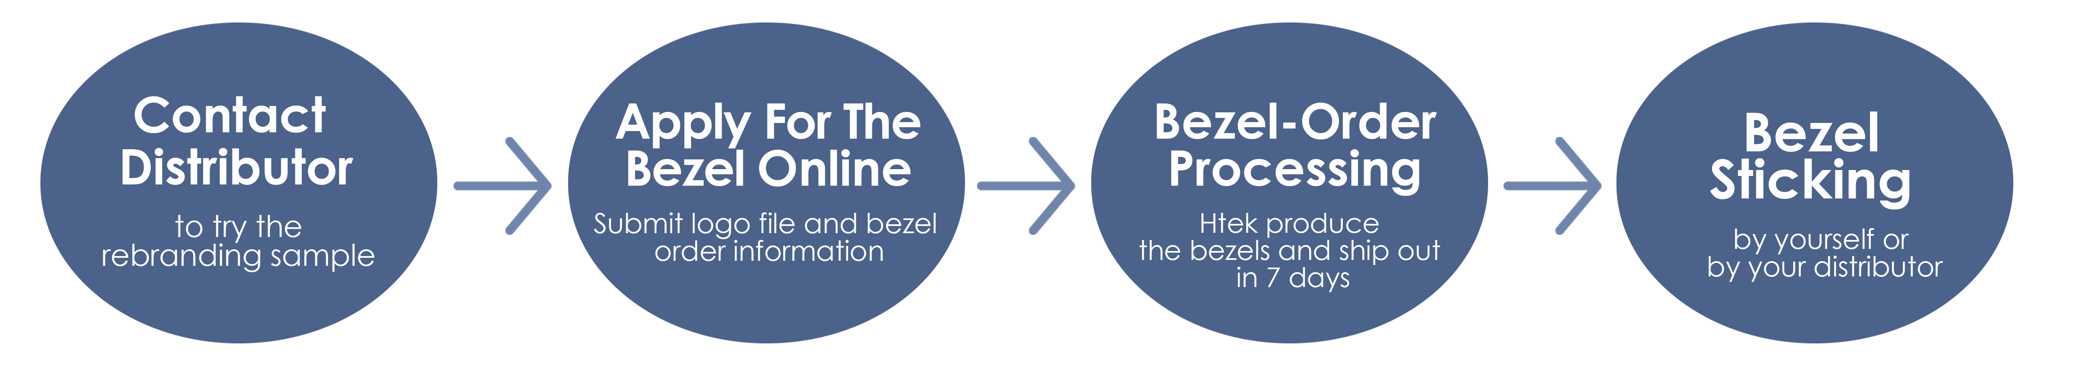
Rebranding process

Slide 10
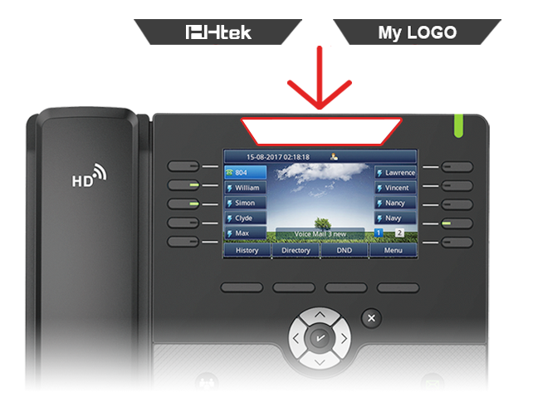
Contact Distributor
If you are interested in re-branding service, contact your local distributor to order the rebranding style sample .
There are two bezels
(Htek &My LOGO) inside:

Slide 11
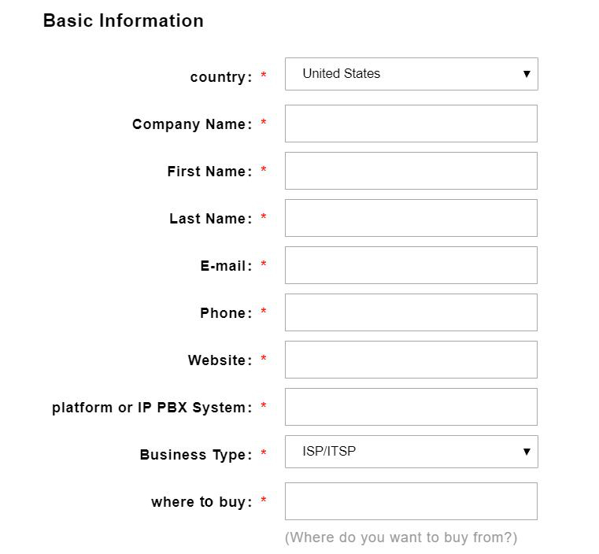
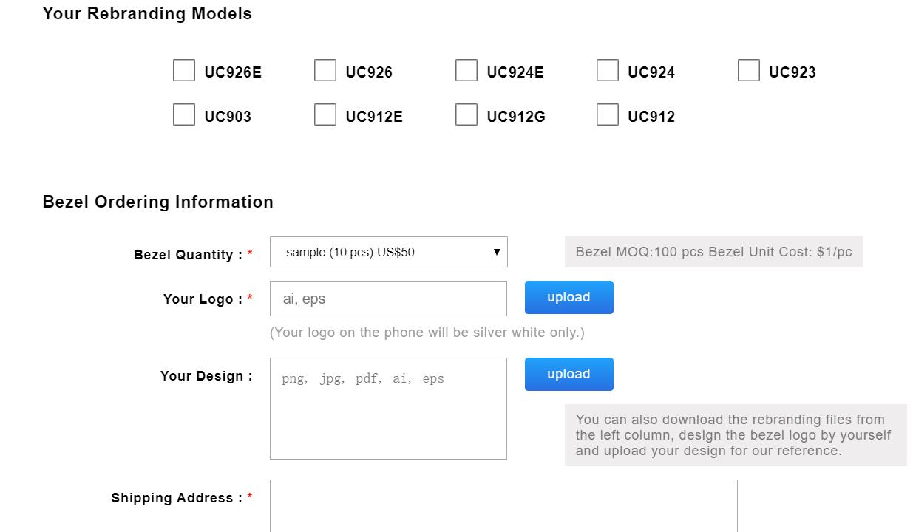
Apply for the bezel online
http://www.htek.com/activity/Easy-Rebranding/index.html
Log in the Htek registration page to fill in the company information and bezel order information
Note: For better printing, we advise that your logo should not have small letters.

Slide 12
Bezel-Order processing
Complete application
for bezel
Htek produce the bezel
and ship out in 7 days.
Confirm the design

Slide 13
Bezel sticking
The Bezel was designed easy to be stuck by hand.
By yourself:
Buy standard rebranding phones from distributor and stick the bezel by yourself.
By the distributor:
Negotiate with your local distributor and pay for the distributor to stick the bezel for you .
A video for reference: https://www.youtube.com/watch?v=wPyVbedg_rY

Slide 14




Please contact us if you have any questions about
the rebranding service .
Contact Us
0086-25-84658050
sales@htek.com
www.htek.com

